Slide 1

Cloud Database

Slide 2
What is Cloud Database?
A cloud database is a database built to run in a public or hybrid cloud environment to help organize, store, and manage data within an organization. Cloud databases can be offered as a managed database-as-a-service (DBaaS) or deployed on a cloud-based virtual machine (VM) and self-managed by an in-house IT team.

Slide 3
Types of Cloud databases
Relational cloud databases consist of one or more tables of columns and rows and allow you to organize data in predefined relationships to understand how data is logically related. These databases typically use a fixed data schema, and you can use structured query language (SQL) to query and manipulate data. They are highly consistent, reliable, and best suited to dealing with large amounts of structured data.
Examples of relational databases include SQL Server, Oracle, MySQL, PostgreSQL, Spanner, and Cloud SQL.

Slide 4
When to use relational database
If you’re creating a project where the data is predictable, in terms of structure, size, and frequency of access, relational databases are still the best choice.
Normalization can help reduce the size of the data on disk by limiting duplicate data and anomalies, decreasing the risk of requiring vertical scaling in future.
Relational databases are also the best choice if relationships between entities are important.
Non-relational databases can store documents within the documents, which helps keep data that will be accessed together in the same place. But if this isn’t right for your needs, a relational database is still the answer. For example, if you have a large dataset with complex structure and relationships, embedding might not create clear enough relationships.
The amount of time that RDMSs have been around also means there is wide support available, from tools to integration with data from other systems.

Slide 5
Types of Cloud databases
Non-relational cloud databases store and manage unstructured data, such as email and mobile message text, documents, surveys, rich media files, and sensor data. They don’t follow a clearly-defined schema like relational databases and allow you to save and organize information regardless of its format.
Examples of non-relational databases include MongoDB, Redis, Cassandra, Hbase, and Cloud Bigtable.

Slide 6
When to use Nosql database
As discussed, there are many types of non-relational databases, each having their own advantages and disadvantages.
However, non-relational databases still maintain some consistent advantages. If the data you are storing needs to be flexible in terms of shape or size, or if it needs to be open to change in future, then a non-relational database is the answer.
Modern NoSQL databases have been designed for the cloud, making them naturally good for horizontal scaling where a lot of smaller servers can be spun up to handle increased load.

Slide 7
Consider a NoSQL datastore when: | Consider a relational database when:
You have high volume workloads that require predictable latency at large scale (e.g. latency measured in milliseconds while performing millions of transactions per second) | Your workload volume generally fits within thousands of transactions per second
Your data is dynamic and frequently changes | Your data is highly structured and requires referential integrity
Relationships can be de-normalized data models | Relationships are expressed through table joins on normalized data models
Data retrieval is simple and expressed without table joins | You work with complex queries and reports
Data is typically replicated across geographies and requires finer control over consistency, availability, and performance | Data is typically centralized, or can be replicated regions asynchronously
Your application will be deployed to commodity hardware, such as with public clouds | Your application will be deployed to large, high-end hardware

Slide 8
Database as a service
Like SaaS, PaaS and IaaS of cloud computing we can consider DBaaS (also known as Managed Database Service) as a cloud computing service. It allows users associated with database activities to access and use a cloud database system without purchasing it.
DBaaS and cloud database comes under Software as a Service (SaaS) whose demand is growing so fast In simple we can say Database as a Service (DBaaS) is self service/ on demand database consumption coupled with automation of operations. As we know cloud computing services are like pay per use so DBaaS also based on same payment structure like how much you will use just pay for your usage. This DBaaS provides same function as like standard traditional and relational database models. So using DBaaS, organizations can avoid data base configuration, management, upgradation and security.

Slide 9
Key Characteristics of DBaaS
A fully managed info service helps to line up, manage, and administer your info within the cloud and conjointly offer services for hardware provisioning and Backup.
DBaaS permits the availability of info’s effortlessly to Database shoppers from numerous backgrounds and IT expertise.
Provides on demand services.
Supported the resources offered, it delivers a versatile info platform that tailors itself to the environment’s current desires.
A team of consultants at your disposal, endlessly watching the Databases.
Automates info administration and watching.
Leverages existing servers and storage.

Slide 10
Cloud file storage and system
What is cloud file storage?
Cloud file storage is a method for storing data in the cloud that provides servers and applications access to data through shared file systems. This compatibility makes cloud file storage ideal for workloads that rely on shared file systems and provides simple integration without code changes.
What is a cloud file system?
A cloud file system is a hierarchical storage system in the cloud that provides shared access to file data. Users can create, delete, modify, read, and write files, as well as organize them logically in directory trees for intuitive access.
What is cloud file sharing?
Cloud file sharing is a service that provides simultaneous access for multiple users to a common set of files stored in the cloud. Security for online file storage is managed with user and group permissions so that administrators can control access to the shared file data.

Slide 11
What to expect from cloud storage
An ideal file-based data storage solution in the cloud must deliver the right performance and capacity for today, while also being capable of scaling as business needs change. The solution should include the following features:
Fully managed: Provides a fully managed file system that can be launched in minutes with no physical hardware required or ongoing software maintenance
Performance: Provides consistent throughput, scalable storage space, and low-latency performance
Compatibility: Integrates seamlessly with existing applications with no new code to write
Security: Provides network security and access control permissions for sensitive data protection
Availability: Redundancy across multiple sites and always accessible when needed
Affordability: Pay only for capacity used with no upfront provisioning costs or licensing fees

Slide 12
Types of cloud storage
File storage
Many applications need to access shared files and require a file system. This type of storage is often supported with a network-attached storage (NAS) server. File storage solutions like Amazon EFS and Amazon FSx are for use cases like content repositories, development environments, machine learning, data science, media stores, and user home directories. Amazon FSx for Lustre is ideal for high-performance computing.
Block storage
Other enterprise applications like databases or enterprise resource planning (ERP) systems often require dedicated, low-latency storage for each host. This is similar to direct-attached storage (DAS) or a storage area network (SAN). Block-based cloud storage solutions like Amazon Elastic Block Store (Amazon EBS) are provisioned with each virtual server and offer the millisecond latency required for high-performance workloads.

Slide 13
Types of cloud storage
Object storage
Applications developed in the cloud often take advantage of object storage's vast scalability and metadata characteristics. Object storage solutions like Amazon Simple Storage Service (Amazon S3) are ideal for building modern applications from scratch that require scale and flexibility, and can also be used to import existing data stores for analytics, backup, or archive. Object storage is built for the internet and comprises buckets and objects. A bucket is a container for objects. An object is a file and any metadata that describes that file. Costs can be lower with object storage because of the scale; it delivers faster retrieval times without folder hierarchy; and its metadata classification allows for greater data analytics.

Slide 14
Google file systems
The GFS is composed of clusters. A cluster is a set of networked computers. Figure 1 shows that, GFS clusters contain three types of interdependent entities which are: Client, master and chunk server.
Clients could be: Computers or applications manipulating existing files or creating new files on the system. The master server is the orchestrator or manager of the cluster system that maintain the operation log.
Operation log keeps track of the activities made by the master itself which helps reducing the service interruptions to a minimum level.
At startup, master server retrieves information about contents and inventories from chunk servers. Then after, the master server keeps tracks of the location of the chunks with the cluster.
The GFS architecture keeps the messages that the master server sends and receives very small. The master server itself doesn’t handle file data at all, this is done by chunk servers. Chunk servers are the core engine of the GFS. They store file chunks of 64 MB size. Chunk servers coordinate with the master server and send requested chunks to clients directly.

Slide 15
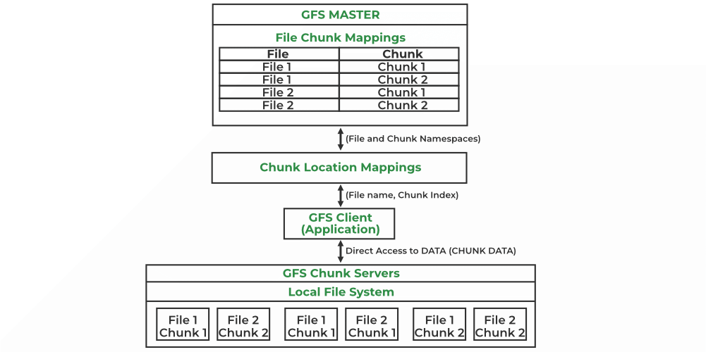
GFS architecture

Slide 16
Hadoop file system
HDFS follows the master-slave architecture and it has the following elements.
Namenode
The namenode is the commodity hardware that contains the GNU/Linux operating system and the namenode software. It is a software that can be run on commodity hardware. The system having the namenode acts as the master server and it does the following tasks −
Manages the file system namespace.
Regulates client’s access to files.
It also executes file system operations such as renaming, closing, and opening files and directories.

Slide 17
Hadoop file system
Datanode
The datanode is a commodity hardware having the GNU/Linux operating system and datanode software. For every node (Commodity hardware/System) in a cluster, there will be a datanode. These nodes manage the data storage of their system.
Datanodes perform read-write operations on the file systems, as per client request.
They also perform operations such as block creation, deletion, and replication according to the instructions of the namenode.
Block
Generally the user data is stored in the files of HDFS. The file in a file system will be divided into one or more segments and/or stored in individual data nodes. These file segments are called as blocks. In other words, the minimum amount of data that HDFS can read or write is called a Block. The default block size is 64MB, but it can be increased as per the need to change in HDFS configuration.

Slide 18


Slide 19
Comparison
Hadoop Distributed File System HDFS | Google File System GFS
Cross Platform | Linux
Developed in Java environment | Developed in c,c++ environment
At first its developed by Yahoo and now its an open source Framework | Its developed by Google
It has Name node and Data Node | It has Master-node and Chunk server
128 MB will be the default block size | 64 MB will be the default block size
Name node receive heartbeat from Data node | Master node receive heartbeat from Chunk server
Commodities hardware were used | Commodities hardware werused
WORM – Write Once and Read Many times | Multiple writer , multiple reader model
Deleted files are renamed into particular folder and then it will removed via garbage | Deleted files are not reclaimed immediately and are renamed in hidden name space and it will deleted after three days if it’s not in use
No Network stack issue | Network stack Issue
Journal ,editlog | Oprational log
only append is possible | random file write possible

